Slide 1

ARTIFICIAL INTELLIGENCE
&
MACHINE LEARNING
SESSION NO : 18
Noise reduction (FFT), outlier detection, imputation (KNN, centrality).

Slide 2
Data Quality: Why Preprocess the Data?
Measures for data quality: A multidimensional view
  Accuracy: correct or wrong, accurate or not
  Completeness: not recorded, unavailable, …
  Consistency: some modified but some not, dangling, …
  Timeliness: timely update?
  Believability: how trustable the data are correct?
  Interpretability: how easily the data can be understood?

Slide 3
Major Tasks in Data Preprocessing
Data cleaning
  Fill in missing values, smooth noisy data, identify or remove outliers, and resolve inconsistencies
Data integration
  Integration of multiple databases, data cubes, or files
Data reduction
  Dimensionality reduction
  Numerosity reduction
  Data compression
Data transformation and data discretization
  Normalization
  Concept hierarchy generation

Slide 4
Data Cleaning
Data in the Real World Is Dirty: Lots of potentially incorrect data, e.g., instrument faulty, human or computer error, transmission error
  incomplete: lacking attribute values, lacking certain attributes of interest, or containing only aggregate data
    e.g., Occupation=“ ” (missing data)
  noisy: containing noise, errors, or outliers
    e.g., Salary=“−10” (an error)

Slide 5
Noisy Data
Noise: random error or variance in a measured variable
Incorrect attribute values may be due to
  faulty data collection instruments
  data entry problems
  data transmission problems
  technology limitation
  inconsistency in naming convention
Other data problems which require data cleaning
  duplicate records
  incomplete data
  inconsistent data
5
Notes:
5

Slide 6
Types of Noise in Machine Learning
Feature Noise: It refers to superfluous or irrelevant features present in the dataset that might cause confusion and impede the process of learning.
Systematic Noise: Recurring biases or mistakes in measuring or data collection procedures that cause data to be biased or incorrect.
Random Noise: Unpredictable fluctuations in data brought on by variables such as measurement errors or ambient circumstances.
Background noise: It is the information in the data that is unnecessary or irrelevant and could distract the model from the learning job.

Slide 7
Ways to Handle Noises
  Data preprocessing: It consists of data cleaning, normalization, and outlier elimination.
  Fourier Transform:
  The Fourier Transform is a mathematical technique used to transform signals from the time or spatial domain to the frequency domain. In the context of noise removal, it can help identify and filter out noise by representing the signal as a combination of different frequencies. Relevant frequencies can be retained while noise frequencies can be filtered out.
Constructive Learning:
  Constructive learning involves training a machine learning model to distinguish between clean and noisy data instances. This approach typically requires labeled data where the noise level is known. The model learns to classify instances as either clean or noisy, allowing for the removal of noisy data points from the dataset.

Slide 8
Ways to Handle Noises
Autoencoders:
  Autoencoders are neural network architectures that consist of an encoder and a decoder. The encoder compresses the input data into a lower-dimensional representation, while the decoder reconstructs the original data from this representation. Autoencoders can be trained to reconstruct clean signals while effectively filtering out noise during the reconstruction process.
Principal Component Analysis (PCA):
  PCA is a dimensionality reduction technique that identifies the principal components of a dataset, which are orthogonal vectors that capture the maximum variance in the data. By projecting the data onto a reduced set of principal components, PCA can help reduce noise by focusing on the most informative dimensions of the data while discarding noise-related dimensions.

Slide 9
Ways to Handle Noises
Fast Fourier Transform (FFT) is a mathematical algorithm widely used in image processing to transform images between the spatial domain and the frequency domain.
Spatial domain: Each pixel in image has color or brightness value and together these values form the image you see. This is the spatial domain—the image described by its pixels.
Frequency domain: Now imagine describing the same image in a different way—not by the pixels directly, but by how patterns of light and dark change across the image.
For example:Low frequencies represent smooth, gradual changes (like large shapes or blurry areas).
High frequencies capture sharp changes (like edges or fine details).
frequency domain shows how much of these patterns (or frequencies) are present in the image)

Slide 10
Ways to Handle Noises
Implementing Fast Fourier Transform in Image Processing
The Fast Fourier Transform (FFT) works in three main steps:
Forward FFT (Spatial to Frequency Domain): FFT converts pixel values from the spatial domain into sine and cosine waves, mapping low frequencies to the center and high frequencies to the edges.
Filtering in the Frequency Domain: Filters are applied to modify certain frequency ranges for purposes like noise removal (by eliminating high frequencies) or sharpening (by enhancing high frequencies).
Inverse FFT (Frequency to Spatial Domain): The modified frequency data is transformed back into the spatial domain, resulting in a processed version of the original image.

Slide 11
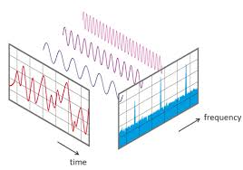
FFT

Slide 12
How to Handle Noisy Data?
Binning
  first sort data and partition into (equal-frequency) bins
  then one can smooth by bin means, smooth by bin median, smooth by bin boundaries, etc.
Regression
  smooth by fitting the data into regression functions
Clustering
  detect and remove outliers
Combined computer and human inspection
  detect suspicious values and check by human (e.g., deal with possible outliers

Slide 13
Simple Discretization: Binning
Equal-width (distance) partitioning
  Divides the range into N intervals of equal size: uniform grid
  if A and B are the lowest and highest values of the attribute, the width of intervals will be: W = (B –A)/N.
  The most straightforward, but outliers may dominate presentation
  Skewed data is not handled well
Equal-depth (frequency) partitioning
  Divides the range into N intervals, each containing approximately same number of samples
  Good data scaling
  Managing categorical attributes can be tricky

Slide 14
Binning Methods for Data Smoothing
Sorted data for price (in dollars): 4, 8, 9, 15, 21, 21, 24, 25, 26, 28, 29, 34
* Partition into equal-frequency (equi-depth) bins:
- Bin 1: 4, 8, 9, 15
- Bin 2: 21, 21, 24, 25
- Bin 3: 26, 28, 29, 34
* Smoothing by bin means:
- Bin 1: 9, 9, 9, 9
- Bin 2: 23, 23, 23, 23
- Bin 3: 29, 29, 29, 29
* Smoothing by bin boundaries:
- Bin 1: 4, 4, 4, 15
- Bin 2: 21, 21, 25, 25
- Bin 3: 26, 26, 26, 34

Slide 15
Outliers
Outliers are data point that is essentially a statistical anomaly, a data point that significantly deviates from other observations in a dataset. Outliers can arise due to measurement errors, natural variation, or rare events, and they can have a disproportionate impact on statistical analyses and machine learning models if not appropriately handled.
Example: If you have the following dataset of student test scores:
[85, 87, 90, 88, 92, 89, 45]
The score 45 is an outlier—it’s much lower than the others.

Slide 16
Outliers
Types of Outliers
Outliers can be classified into various types based on their characteristics:
Global Outliers: Also known as point anomalies, these data points significantly differ from the rest of the dataset.
Contextual Outliers: These are data points that are considered outliers in a specific context. For example, a high temperature may be normal in summer but an outlier in winter.
Collective Outliers: A collection of data points that deviate significantly from the rest of the dataset, even if individual points within the collection are not outliers.

Slide 17
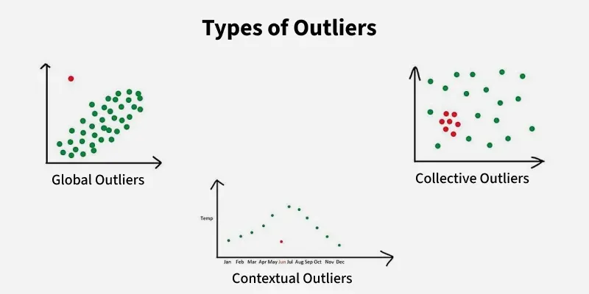

Slide 18
Outliers
Standard Deviation Method
Standard Deviation Method is based on the assumption that the data follows a normal distribution. Data points outside of three standard deviations from the mean are considered outliers.
It is commonly used for univariate data analysis where the distribution can be assumed to be approximately normal.
Step 1: Calculate the average and standard deviation of the data set, if applicable.
Step 2: Define the lower and upper bounds for outliers.
Step 3: Identify outliers as data points that fall outside these bounds:
Example: Dataset: [1, 2, 2, 3, 1, 3, 10]. Find an outlier using the Standard Deviation Method.

Slide 19
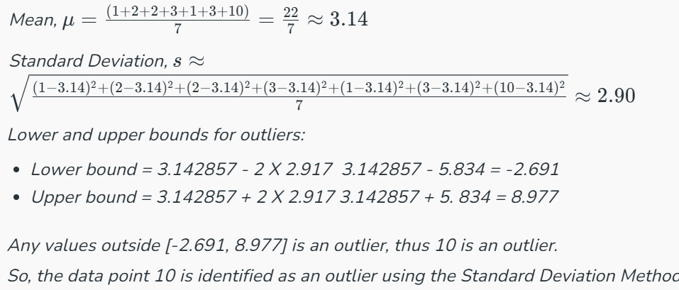

Slide 20
Z-Score Method
Z-Score Method
The Z-score method calculates the number of standard deviations each data point is from the mean. A Z-score threshold is set, commonly 3, and any data point with a Z-score exceeding this threshold is considered an outlier. This method assumes a normal distribution and is sensitive to extreme values in small datasets.
Step 1: Calculate the mean.
Step 2: Compute Standard Deviation
Step 3:Calculate z-scores
Step 4: Apply Threshold Rule: Mild outlier: |Z| > 2 and Extreme outlier: |Z| > 3

Slide 21
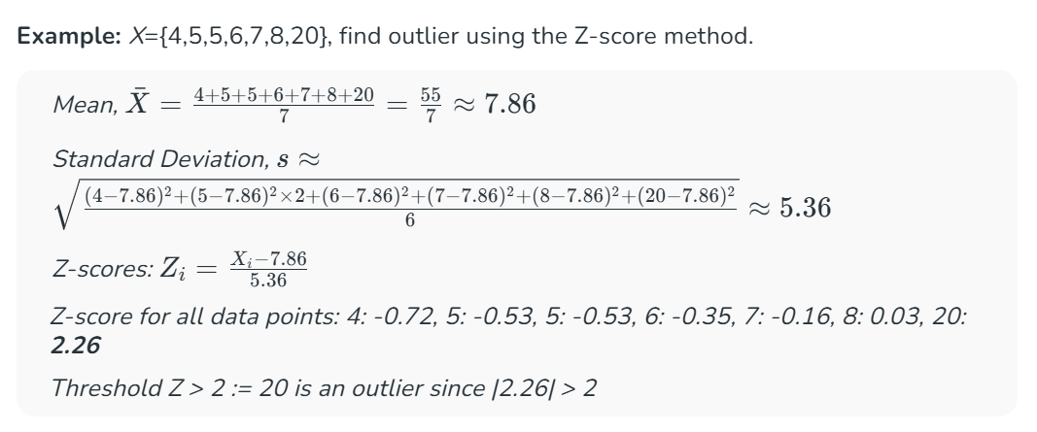
Z-Score Method

Slide 22
Five Number Summary and Box Plot
One of the most popular ways to detect the outliers in a dataset is by using boxplot visualization
Suppose, we have a distribution and need to detect and remove the outliers.
data_distribution = [1, 2, 2, 2, 3, 3, 4, 5, 5, 5, 6, 6, 6, 6, 7, 8, 8, 9,27]
The 5 number summary which is: minimum, first quartile, median, third quartile, and maximum are as follows :
Minimum: It represents the minimum value of the distribution. In this case, it is 1
first quartile: It is also known as the 25 percentile. A percentile is a value below which a certain percentage of the observations lie. Here, the first quartile is 3 which means 25% of the observations in the distribution lie below the value 3.
Median: A median is a middle number in a sorted list of numbers. In this case, the median is 6.5.
third quartile: It is also known as the 75 percentile. Here, the third quartile is 5 which means 75% of the observations in the distribution lie below the value 5.
Maximum: It represents the maximum value of the distribution. In this case, it is 27

Slide 23
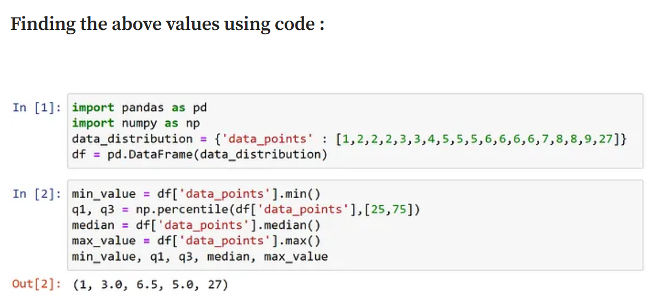
Five Number Summary and Box Plot

Slide 24
The Interquartile Range (IQR)
The Interquartile Range (IQR) method focuses on the spread of the middle 50% of data. It calculates the IQR as the difference between the 75th and 25th percentiles of the data and identifies outliers as those points that fall below 1.5 times the IQR below the 25th percentile or above 1.5 times the IQR above the 75th percentile. This method is robust to outliers and does not assume a normal distribution.
Step 1: Find Q1(25th percentage) and Q3(75th percentage)
Step 2: IQR = Q3 - Q1.
Step 3: Find Lower Bound: Q1 - 1.5 × IQR and Upper Bound Lower Bound: Q1 - 1.5 × IQR
It is suitable for datasets with skewed or non-normal distributions. Useful for identifying outliers in datasets where the spread of the middle 50% of the data is more relevant than the mean and standard deviation.

Slide 25
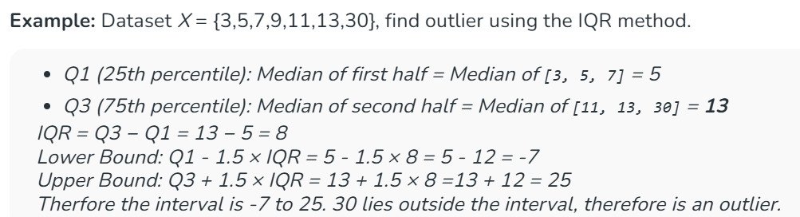
Box Plot

Slide 26
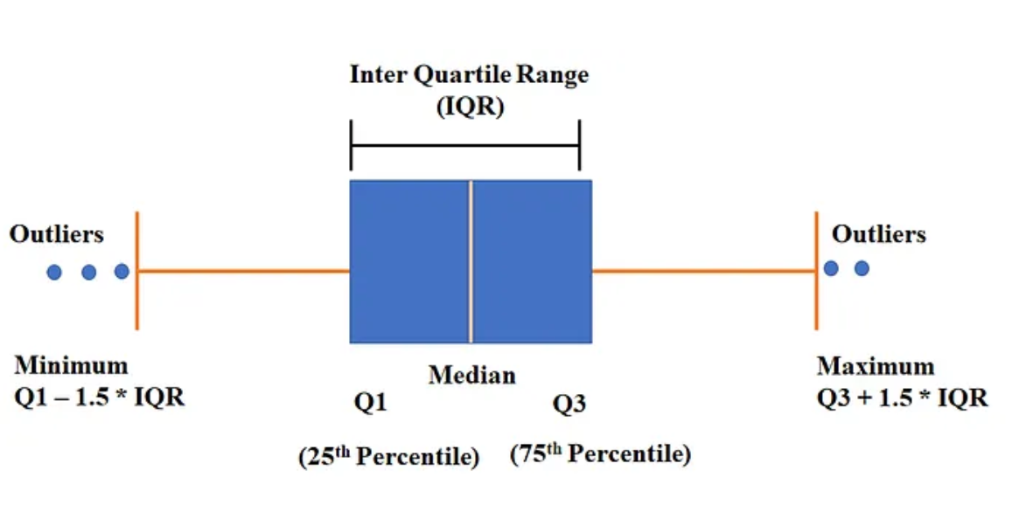
Box Plot
Box Plot is a type of visualization that shows the data from a five-number summary including one of the measures of central tendency. The components of the box plot are shown below :

Slide 27
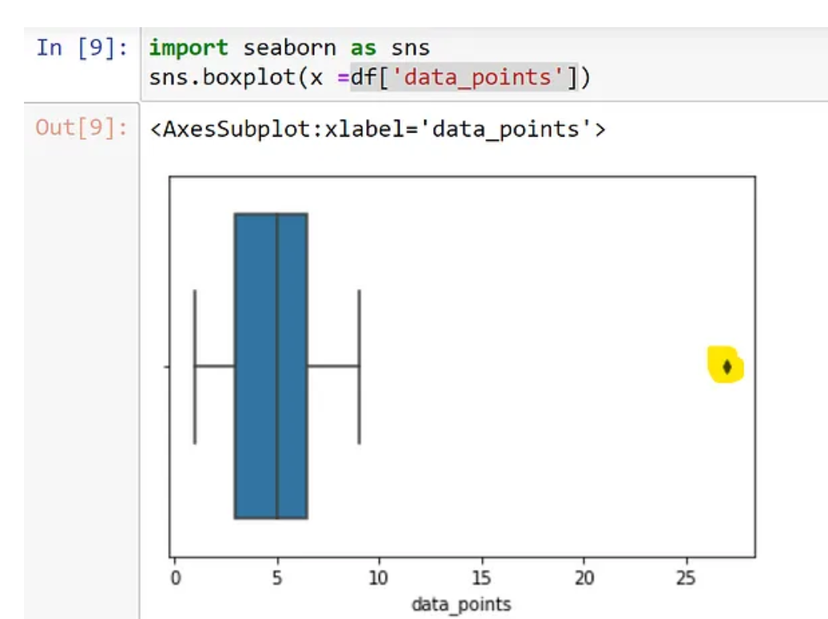
Box Plot

Slide 28
Incomplete (Missing) Data
Data is not always available
  E.g., many tuples have no recorded value for several attributes, such as customer income in sales data
Missing data may be due to
  equipment malfunction
  inconsistent with other recorded data and thus deleted
  data not entered due to misunderstanding
  certain data may not be considered important at the time of entry
  not register history or changes of the data
Missing data may need to be inferred

Slide 29
How to Handle Missing Data?
Ignore the tuple: usually done when class label is missing (when doing classification)—not effective when the % of missing values per attribute varies considerably
Fill in the missing value manually: tedious + infeasible?
Fill in it automatically with
  a global constant : e.g., “unknown”, a new class?!
  the attribute mean
  the attribute mean for all samples belonging to the same class: smarter
  the most probable value: inference-based such as Bayesian formula or decision tree

Slide 30
KNN Imputation of missing values
K-Nearest Neighbors (KNN) imputation replaces missing values by finding the ‘K’ most similar data points (neighbors) and averaging their values.
Steps:
Standardize the Data — Normalize numerical features to avoid bias due to different scales.
Choose K — Select an appropriate number of neighbors (K). Common values range from 3 to 10.
Compute Distance — Use Euclidean, Manhattan, or other distance metrics to find the nearest neighbors.
Impute Missing Values — Replace missing values with the mean (for continuous data) or mode (for categorical data) of the nearest neighbors.
Verify Results — Check if the imputed values make sense in the context of the data.

